Slide 1

Open Accessibility for Open Source
Chris Knapp
Accessibility Consultant/Tester
OW2con’24 June 11-12, 2024 Paris, France
www.SakaiLMS.org
Notes:
Bonjour!
my name is Chris Knapp, I’m an accessibility consultant/tester.
I’m here today representing Sakai, which is an open-source Learning Management System, and over the next 10 minutes or so, I’ll be talking about our multi-year effort to develop and implement a community-sourced accessibility strategy, that eventually led to us being able to produce our own VPAT, or Voluntary Product Accessibility Template.
And hopefully, by the end of my presentation, you’ll have some high level concepts that you can apply to your own open source projects, if any of you are interested in trying to replicate our approach to this work.

Slide 2

Sakai’s Accessibility Journey 2020 - Present
2020
Joins Sakai community as an embedded resource with the Sakai QA Team
First substantive, stand-alone accessibility test script developed
Sakai begins partnership with Vision-Aid and adds several more blind/low-vision testers
2021
Concerted effort is made to bulk up accessibility testing of “high stakes” tools
Sakai 21.0 released
Sakai Accessibility Team assists with user testing/analysis for Sakai 21 VPAT
2022
Sakai 22 testing performed across total of 23 tools/features
Students from Marist College recruited to help with “Accessibility LITE” keyboard testing
Sakai 22.0 released
2023
Decision is made to utilize internal resources to create our own VPAT
Work commences to align accessibility strategy with the VPAT creation process
Sakai 23.0 released
2024
Sakai 23 testing performed across total of 29 tools/features
Sakai community creates/issues its own VPAT
Notes:
This slide depicts several key milestones that occurred over the past 4 years that have been critical getting us to this point.
I know that there is a lot of content here, and there’s no way you will be able to read all of this small font, so I’m just going to try and quickly summarize what’s here.
My involvement with Sakai started in 2020.
That’s when Chuck Severance, who is Sakai’s Chief Architect and currently serves as the Sakai PMC Chair, had approached me about getting involved with Sakai.
Chuck’s approach, which proved to be genius, was to embed me with Sakai’s QA team, where I was to begin evaluating the current state of accessibility for Sakai, not just the accessibility of the Sakai LMS product itself, but accessibility across every facet of the open source Sakai community.
So I started working as a member of the Sakai QA team, and began making recommendations about how to make the different tools and processes we were using more accessible.
I created our first, real substantive accessibility test script, and began performing screen reader/keyboard testing to supplement the efforts of our other QA testers.
Then about 3 months into our little experiment, we established a partnership with Vision-Aid, which provides IT training to blind/low-vision individuals in India, and suddenly tripled the number of blind/low-vision testers working on Sakai.
Around that same time, we began piloting a new initiative we call “Accessibility LITE” which involves having some sighted users go through and perform keyboard testing on an adapted version of our accessibility test script.
When it was time to create the Sakai 21 VPAT, our accessibility team actually had plenty to contribute, however, we ultimately decided to utilize an outside contractor to create the Sakai 21 VPAT.
But by the time of the Sakai 22 release, we had built up enough of the accessibility resources within our community, that we made the decision to try and utilize internal resources to create our own VPAT, which is ultimately what we did.

Slide 3
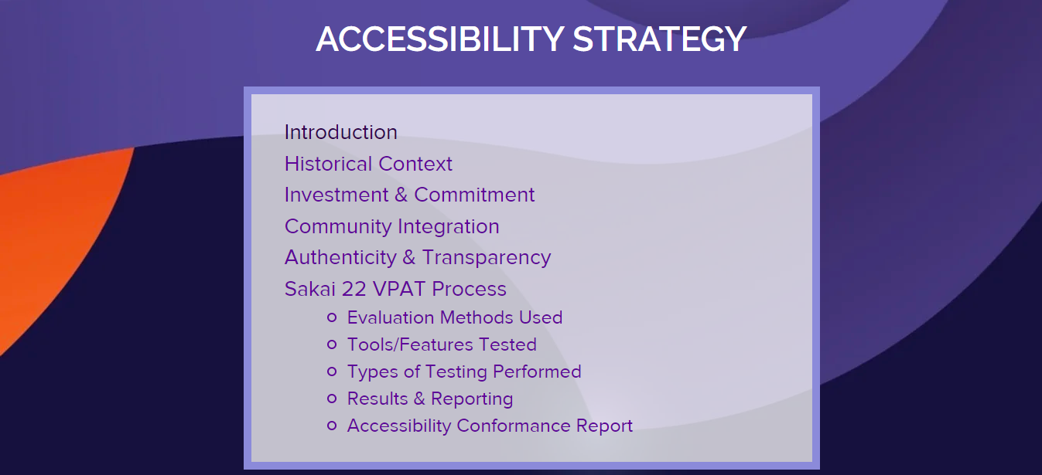
https://www.sakailms.org/accessibility/accessibility-strategy
Notes:
Now, we won’t have time to get into our entire process, so I wanted to refer you to this page on our Sakai LMS web site where you can find all of the information about our Sakai Accessibility Strategy, including the Sakai 22 VPAT, which you can access here in the “Accessibility Conformance Report” section down at the bottom.

Slide 4
Sakaiger
Selfie!
Tales of the Reluctant Blind
https://www.knappstrategic.com/accessiversity-blog
Notes:
This is another URL that you’ll want to remember, and again, its kind of long, so maybe take a photo of the slide, or just remember to Google “Tales of the Reluctant Blind” which is the name of my blog.
I just posted an article last week titled, “Voluntarily Excellent When It Comes To Accessibility” that you might be interested in reading to help fill in some of the blanks, as I’m certain that I’ll have to gloss over a lot of the parts of our VPAT process with the limited time we have today.
So, in the time we have remaining, I thought I would try to quickly touch on some key themes.

Slide 5


The underlying strategy is more important than the actual VPAT
Notes:
So, here I have a copy of the Sakai 22 VPAT.
While the goal was to be able to produce our own VPAT, at the end of the day, these 30 or so pages of paper are not as important as the underlying strategy that is helping to drive all of this work.
If you don’t retain anything else from my talk today, at least remember to go to that page on the Sakai LMS web site and read about the Sakai Accessibility Strategy, because that is absolutely key to everything.
Starting with a robust accessibility strategy is like having a well-stocked kitchen. Its likely that you will already have all of the ingredients you will need to create a VPAT. On the other hand, creating a VPAT without an accessibility strategy is like running to the store to get ingredients for a specific recipe. You can do it, but you might waste a lot of time and energy tracking down everything you need, and you’ll only ever be able to make that one item.
So eclairs yes, but no apple pie, no New York style cheese cake, no chocolate chip cookies.
A VPAT is a point in time, your accessibility strategy is what has staying power
Regardless of where you’re at in the process, being able to substantiate that you’re taking the necessary steps to maintain/improve the accessibility of your product,
can provide you with much needed air cover – before, during, and after your VPAT project.

Slide 6
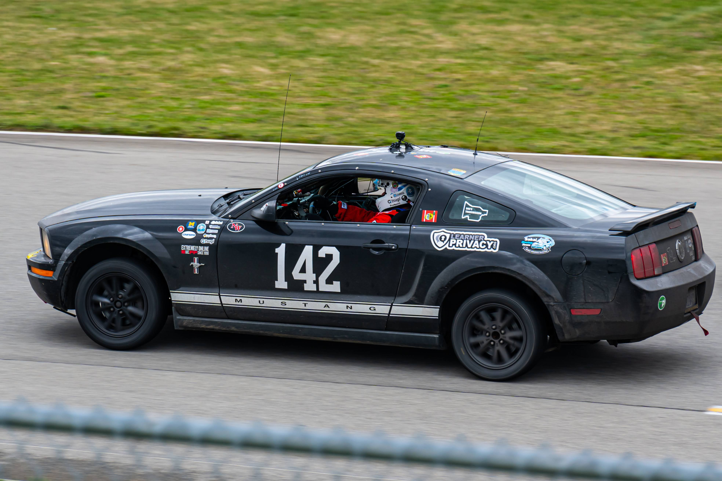

It’s more important to get it right
than to be the first across the finish line
Notes:
Yes, we actually have a Sakai racing team which competes on the “24 Hours of Lemons” racing circuit, which fittingly, is an endurance race.
Again, this has been a 4 year journey to get to this point, and that’s okay – it’s a marathon, not a sprint.
Admittedly, this has been a drawn out process, but it was because we were refining our strategy, and aligning it to the VPAT process, and working on the Sakai 22 and Sakai 23 VPATs, all at the same time.
A lot of the delay had to do with us evolving through several different iterations of our preferred VPAT format. The early draft of our Sakai 22 VPAT doesn’t look anything like the version Vision-Aid and I created last summer, and that’s drastically different then the final version that Gonzalo Silverio (our informal V PAT advisor) had worked with us on.
At times the process was frustrating, and redesigning and reworking entire sections of the VPAT was painful, but eventually we got it right, and hopefully the hard part is behind us now.
Instead of dwelling on how long the VPAT process was taking us, we tried to focus on the positives.
Something that could be perceived as a negative, for instance, it taking more than a year to create the Sakai 22 VPAT, we turned into a positive, by including that extra perspective/context in our supplemental materials, for example, by emphasizing that the high volume of user testing equates to us being more thorough.
And that’s something that we can quantify and actually attach a number to – of the 2853 test cases performed, only 91 had to initially be failed
Eventually, everything you do related to accessibility supports your strategy, and it all becomes part of your accessibility story.

Slide 7
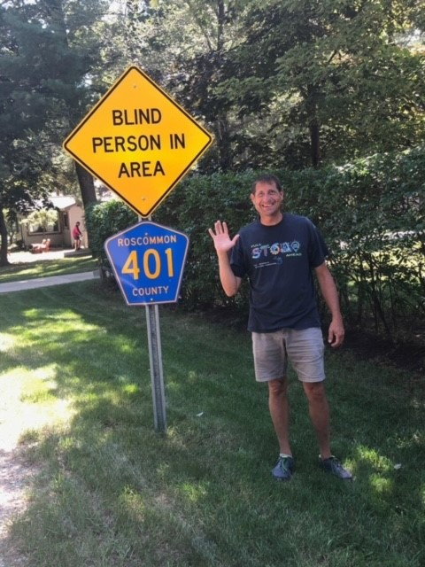
Authenticity matters and promotes credibility
Notes:
As you can tell by this photo, I don’t mind poking fun at myself – I believe I have a great sense of humor, and this is just another example of me being my authentic self.
Now, when you talk about authenticity as it relates to your accessibility strategy and VPAT, this can mean a few different things.
First, to the extent you are able, you should try to incorporate individuals with disabilities into your user testing/community.
Individuals with disabilities, for example blind/low-vision users who rely on screen readers and other assistive technology, are able to provide for an authentic accessibility experience.
Also, when putting together your VPAT, don’t be afraid to give an honest assessment of your product, warts and all.
No software is perfect – if you are portraying your project as flawless either you’re being disingenuous or you haven’t tested enough.

Slide 8

You don’t have to match your big commercial competitors dollar-for-dollar,
but your commitment to, and investment in accessibility must be long-term
Notes:
Well, nothing says long-term commitment better than an image of a couple tying the knot in front of an iconic French landmark. I hope this guy is in it for the long haul, especially for the sake of the bride’s father who probably forked out a small fortune for this little shindig.
The message here is that when it comes to your investment in accessibility, you don’t have to keep up with your commercial competitors.
Chances are that you won’t be able to compete with them anyways, at least not from a strictly dollars and cents standpoint.
For example, when I look at Sakai’s competitors in the LMS space, there’s no way that we can match them in terms of their accessibility spend.
They have the resources to employ entire teams of developers who exclusively focus on accessibility.
They have armies of analysts and lawyers that craft these elaborate VPAT reports that look like they belong on a coffee table.
So, instead of trying to be something that we’re not, we focus on being the best version of who we actually are.
As an open source community, our model provides for direct input from users, which often translates into us being more responsive to our customers
Having a visually impaired person serve as the Lead of our Accessibility Team demonstrates that we not only care about accessibility, but that we value the contributions of individuals with disabilities to the point that we recruit them into our community as full-fledged members.
Remember, VPATS aren’t just for the affluent corporations with access to the almighty dollar, they’re also free marketing tools for those resourceful organizations who can figure out creative ways to tell their stories, and separate themselves from the crowd.

Slide 9
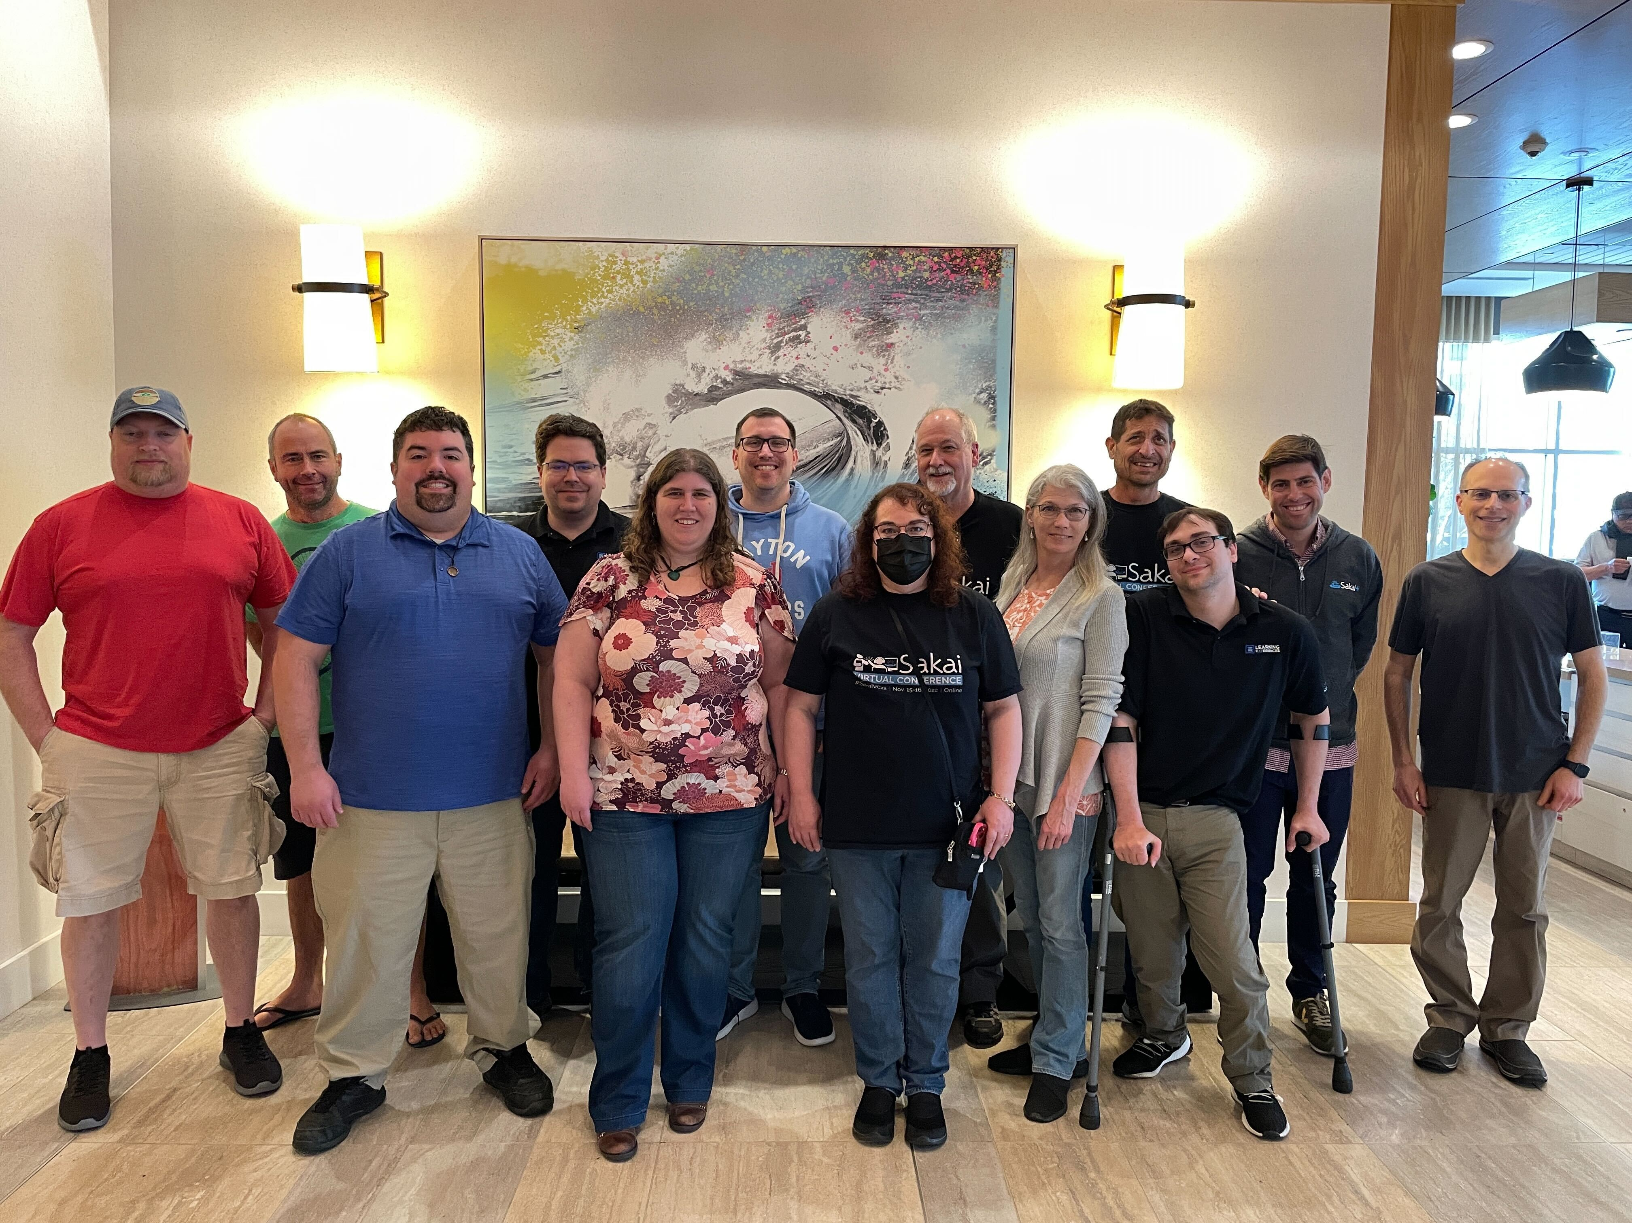
A community-sourced approach to accessibility is essential and powerful
Notes:
As open source projects, you already value this concept of community, and understand its importance in terms of specialization, and diversity, and where different contributions are coming from.
Well, its no different when you are talking about a community-sourced approach to accessibility.
Using Sakai as an example…
We have blind/low-vision testers.
We have sighted users who are performing keyboard testing on an adapted version of our accessibility test script.
We have developers who are well versed in accessibility and accessible design.
We have commercial affiliates who are willing to invest staff resources/funding to advance our accessibility goals.
Everybody has something to contribute, and it all starts to add up, and before you know it, you have a mature accessibility strategy which is key to being able to do your own VPAT.

Slide 10
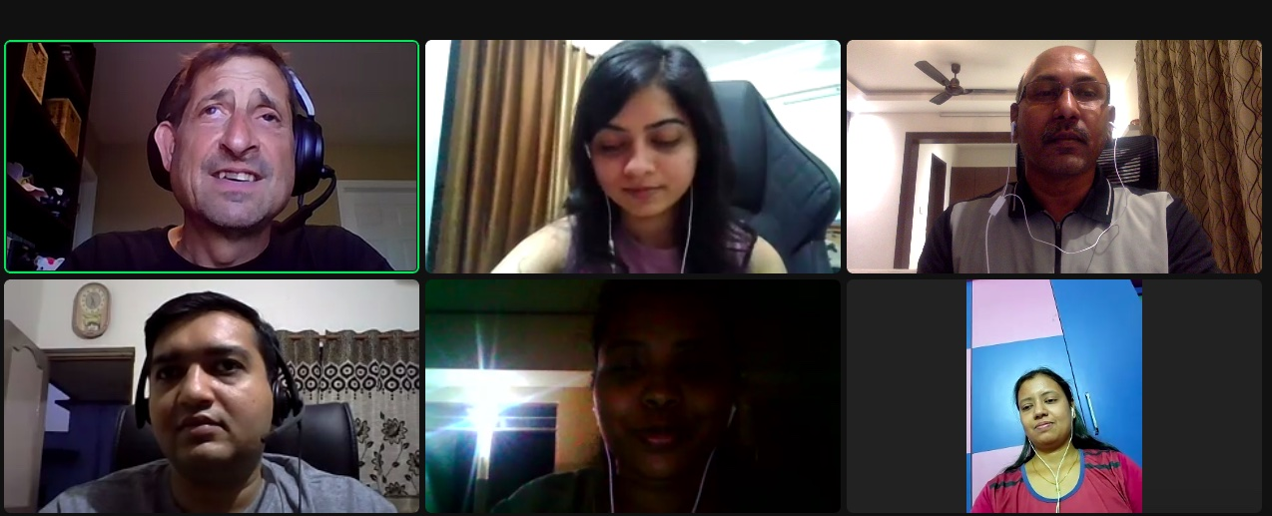
Screenshot from one of Chris’ regular sync-up calls with part of the Vision-Aid team based in India. Pictured in the photo (top row, from left to right) Chris, Sheetal, and Vijay (bottom row, from left to right) Bhargav, Satya, and Megha.
Notes:
This is a screenshot from one of my regular sync-up calls with part of the Vision-Aid team based in India.
It goes without saying that none of this would have been possible without the contributions of Vision-Aid.
While I was responsible for building out our accessibility test script, and performing the initial round of testing on any new tools/features that were added during our Sakai 22 testing, it was the Vision-Aid team who completed the lion’s share of the 2,853 test cases performed across a total of 23 Sakai tools/features.
This was no easy feat, because when we transitioned from Sakai 21 to Sakai 22, we increased the total number of test cases performed by 185%.
Along with all of the user testing, Vision-Aid compiled the detailed WCAG audit findings which became the basis of our VPAT analysis/report. I leaned on them throughout the various phases of the project, many times deferring to their experience and expertise.
If it wasn’t for Vision-Aid serving as my sounding board, going along with some of my far-fetched ideas, and pushing back when necessary, this iterative process never happens, and we’re unable to turn our VPAT from something that is typically transactional, to something that is truly transformative.

Slide 11
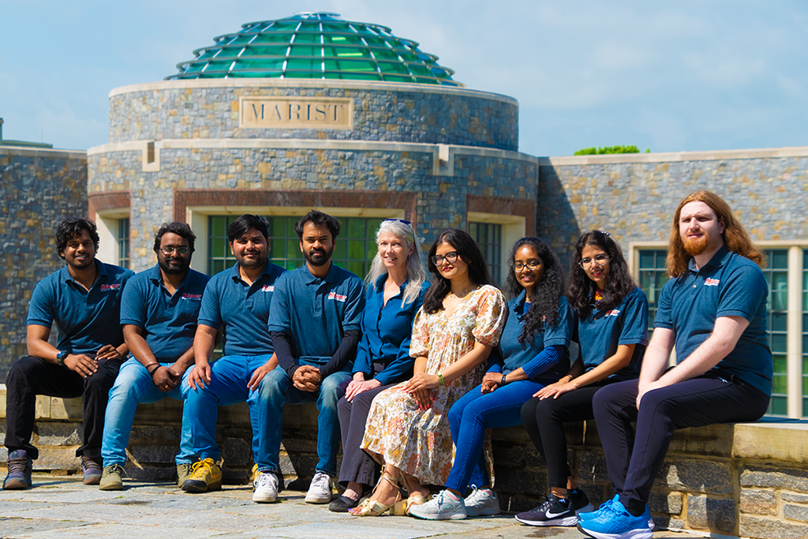
Part of the team from Marist College
Pictured from left to right: Charan Epuri , Mohan Raghudev Pulligilla, Jayasimha Reddy Kalla, Vaibhav Meshram, Dede Hourican, Chandrika Neradabilli, ShivaPriya Poolapally, Sucharitha Gaini, and Matthew Zeppetelli.
Notes:
This is part of the team at Marist College.
We would have struggled to take on a project of this scale, if not for the support of our open source community.
As we commenced our work on the Sakai 22 VPAT, one of the first things that we did, was have the students from Marist College go through and complete keyboard testing on an adapted version of our accessibility test script.
These are sighted individuals who serve as part of our regular Sakai QA team.
We refer to this first round of user testing as “Accessibility LITE” as the students were just trying to verify whether various tasks in Sakai could be completed using only the keyboard, which serves as a sort of early warning system for identifying potential accessibility problems.

Slide 12
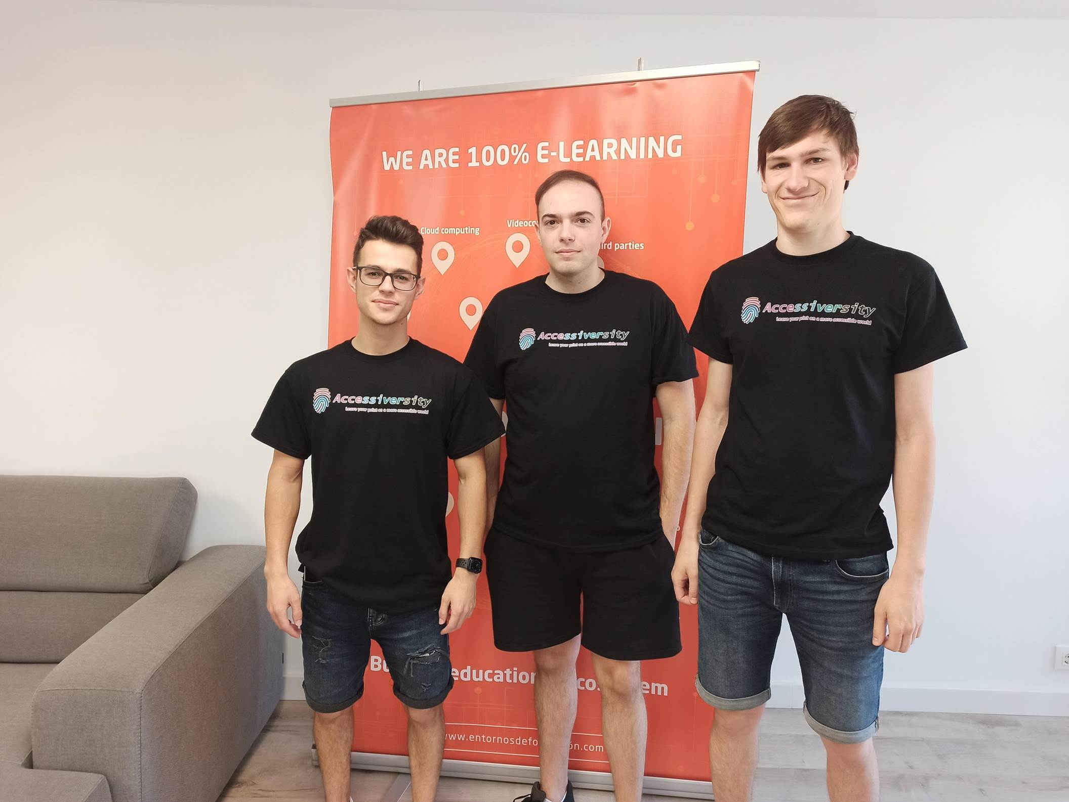
The Team at Entornos de Formación
“We are helping to leave our prints on a more accessible world by leveraging our work with the next generation digital learning environment to constantly evolve the Sakai LMS to be as accessible and as user friendly as possible”
Notes:
This is part of the EDF team that I occasionally get to collaborate with on different accessibility projects.
From left to right: Vicent Alfonso, A11Y developer in the Sakai LMS / Entornos de Formación; José Cebellán, Senior full-stack developer in the Sakai LMS / Entornos de Formación; and Markus Stetschnig, UX developer in the Sakai LMS / Entornos de Formación.

Slide 13
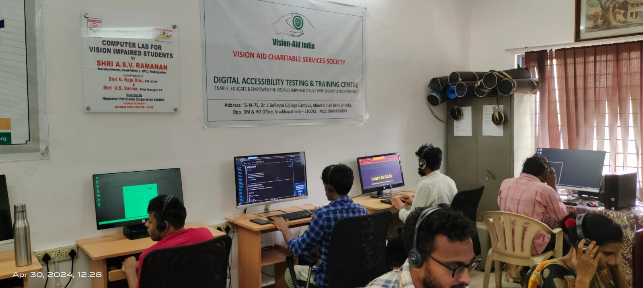
Photos of Chucks recent trip to India
Vision Aid staff working in DATT Center
Chuck with Bhargav and Vijay from Vision-Aid
Chuck touring Institute for Vision Rehabilitation in India
Vision Aid DATT Center
Notes:
These are some photos of Dr. Chuck’s recent trip to India, where he got to meet some of the Vision-Aid staff supporting the Sakai Project, tour the Vision-Aid DATT (Digital Accessibility Testing & Training) Center, and visit the Institute for Vision Rehabilitation and learn about many of their programs and services.

Slide 14
Thank You!
Chris Knapp
517-881-4256
Accessibility@SakaiLMS.org
www.SakaiLMS.org/Accessibility/Accessibility-Strategy
Notes:
So, that’s about all of the time that we have.
I really appreciate having had the opportunity to present to you today.
On behalf of myself and the entire Sakai open source community, thank you all for your time and attentiveness.

